Slide 1

InnerCalm: AI-Driven Emotional Healing & Trauma Recovery
Transforming Mental Wellness Through Intelligent Compassion
Empowering people to heal trauma with cutting-edge AI support that understands your unique emotional journey.

Slide 2

The Mental Health Crisis We're Addressing
970M
people worldwide affected by mental health disorders
$1trillion
annual economic impact of depression and anxiety
76%
of people don't receive adequate mental health support
Unresolved Trauma
affects relationships, work, and daily life
48 days
average wait time for mental health treatment

Slide 3
Our Solution
InnerCalm-AI-Powered Emotional Healing Companion Make emotional healing accessible, personalized, and effective through AI
AI-Driven Personalization
Multimodal Expression
Community Healing
AI-managed support groups and peer circles
Seamless integration with licensed therapists 24/7 emotional support that learns, adapts, and grows with users

Slide 4








Why Current Solutions Fall Short
Long Wait Times
Months-long delays for therapy appointments
Overwhelmed Resources
Emergency rooms unprepared for mental health crises
Generic Approaches
One-size-fits-all treatments lack personalization
Tech Integration Gaps
Limited use of AI for emotional understanding

Slide 5





InnerCalm's Solution: Core Innovations & Features
AI-Powered Personalization
Tailored healing pathways based on individual trauma patterns
Real-Time Recognition
Advanced mood and thought pattern detection with adaptive responses
Evidence-Based Exercises
Guided meditation, CBT techniques, and trauma recovery protocols
24/7 Digital Companion
Always-available support complementing professional care

Slide 6








Technical Architecture & AI Capabilities
Machine Learning Models
Secure Infrastructure
Longitudinal AI memory system
Voice Journaling

Slide 7

User Journey & Experience
Professional Connection
Interactive Healing Modules
Seamless escalation to live therapists when needed.
Daily Support & Growth
Assessment & Personalization
Conversational AI provides check-ins and adaptive guidance.
Progress through therapy exercises that evolve with you.
AI-driven emotional assessment creates your unique healing plan.

Slide 8

Community & Professional Integration
Shared Wound Groups
Connect with others on similar healing journeys in moderated, safe spaces.
Therapist Dashboard
Licensed professionals monitor progress and intervene through the platform.
Peer Healing Circles
Coordinated treatment tools keep all providers aligned with your needs.
Curated Resource Library
Access vetted self-help materials tailored to your specific journey.

Slide 9
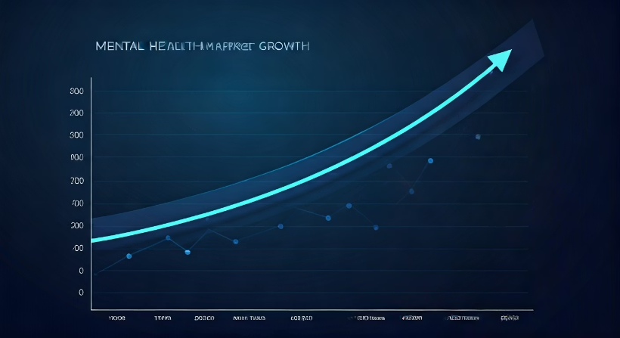
Market Opportunity
Economic Impact
$190B annual loss in U.S. due to mental illness productivity drop.
Growing Demand
33% of Americans prioritize mental health in 2025.
Expanding Market
Global mental health sector shows double-digit growth trajectory.
Positioned for Success
InnerCalm addresses critical gaps in trauma and emotional care.

Slide 10
Social Impact
Accessible mental health for underserved populations
Reduced stigma through anonymous community features
Early intervention preventing crisis escalation
Bridge to professional care when needed

Slide 11
Thank You

